Slide 1
fEMG Crash Course
Quick and fast

Slide 2
What is fEMG?
“Facial electromyography [fEMG] refers to an electromyography technique that measures muscle activity by detecting and amplifying the tiny electrical impulses that are generated by muscle fibers when they contract” —Wikipedia

Slide 3
Quick notes
I’m no pro, just sharing knowledge!
Ask questions! (even if I don’t know the answers)
Keeping it general (pseudo-code, gloss over, etc.)

Slide 4
What is fEMG?
“Facial electromyography [fEMG] refers to an electromyography technique that measures muscle activity by detecting and amplifying the tiny electrical impulses that are generated by muscle fibers when they contract” —Wikipedia

Slide 5
How to muscles work?
Smallest unit of a muscle is the motor unit (myocyte)
Motor unit = cell body and axon of a motor neuron and the muscle fibres it innervates
Each muscle fiber is enclosed by a cell membrane and surrounded by sodium and potassium ions (Na⁺ and K⁺)
When muscle is relaxed, there is more Na⁺ outside the cell than inside
The difference in charge between inside and outside of cell is about -80mV (more positive outside)
When electrical current is sent to the muscle, Na⁺ passes through the membrane into the cell

Slide 6
How to muscles work?
This passage of Na⁺ into the cell, increasing the voltage
If the difference in charge reaches a threshold (~ -30mV), voltage-gated Na channels open, allowing the influx of Na into the cell, causing depolarization
This leads to an overshoot in the charge of ~80mV
The cell then closes the Na channels and opens VG-K channels, allowing K to flow out of the cell, leading to rapid repolarization, where the cell returns to baseline charge (or slightly below)

Slide 7
How do muscles work?

Slide 8
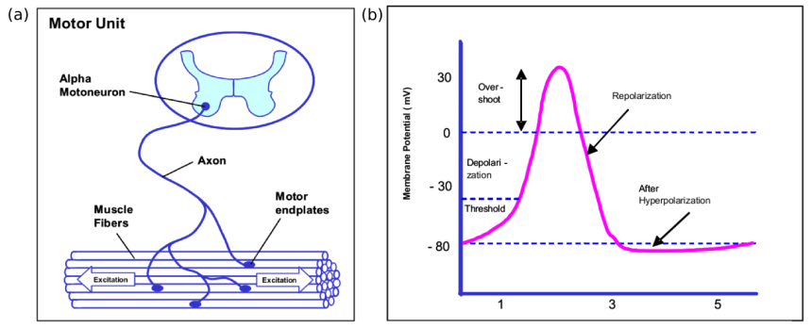
How do muscles work?

Slide 9
What do we measure with fEMG?
In our lab, we use surface EMG
This means we measure a group of motor units (a muscle) with an electrode on the skin.
Therefore, we are recording the sum of all the depolarizations of the motor units over the surface of the electrode, in Volts.
Note. This means the fEMG signal can be positive or negative (before depolarization vs. after). This will be important later on during signal processing.

Slide 10
Why would we measure fEMG?
The face has many muscles (~43) we can measure the signal for.
Many of these have a long history in the psychology of emotion as communicating information about difference emotional processes.
Specifically, they are thought to communicate the valence of emotional experience.
This is different than other physiological measure that index arousal (SCR, HR, and pupillometry)

Slide 11
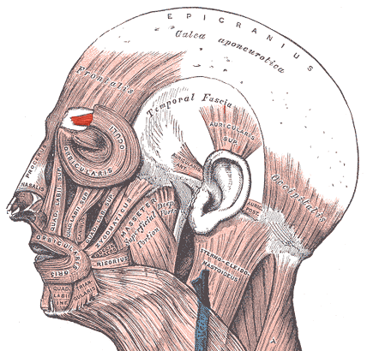
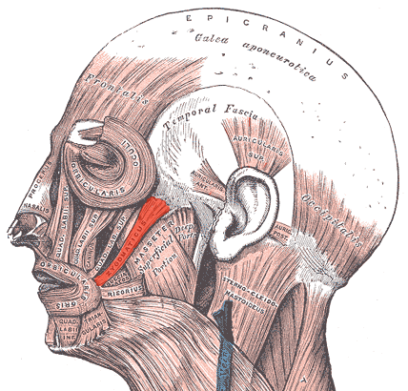
What muscles do we care about?
The most common muscle signals we extract are from the corrugator supercilii and the zygomaticus major

Slide 12
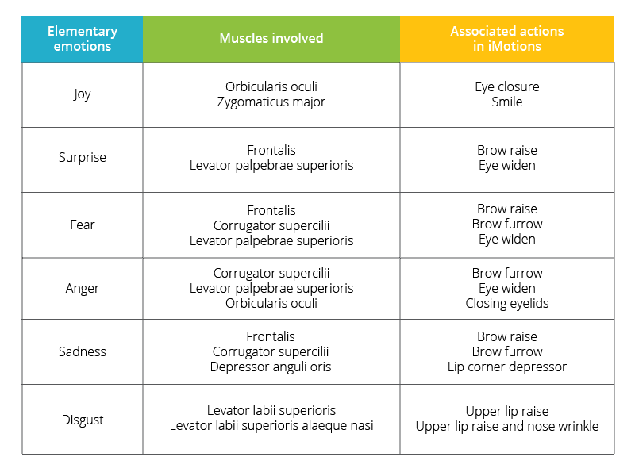
What muscles do we care about?
The most common muscle signals we extract are from the corrugator supercilii and the zygomaticus major, but others are possible

Slide 13
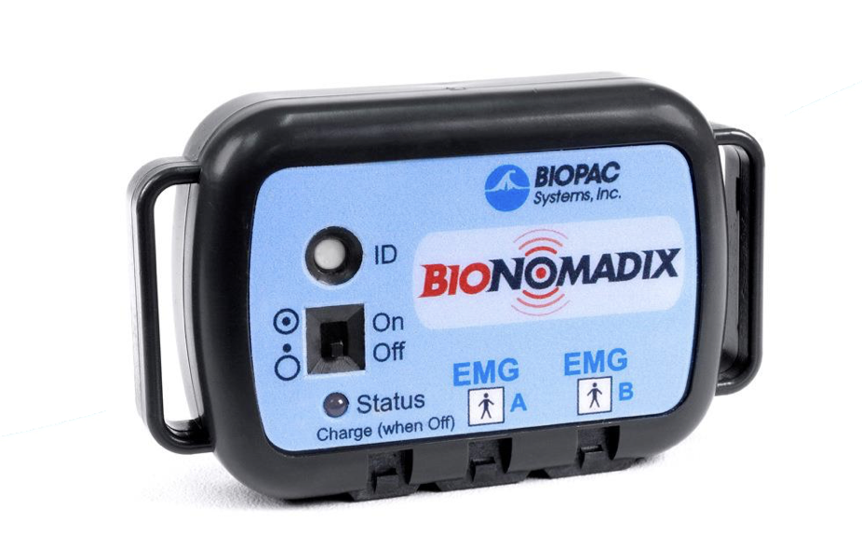
Brief protocol for measure fEMG in our lab
We use a wireless receptor known as a BIONOMADIX. Sends signal to BIOPAC.
By convention:
- EMG A = Zygomaticus
- EMG B = Corrugator
Inputs for electrodes

Slide 14
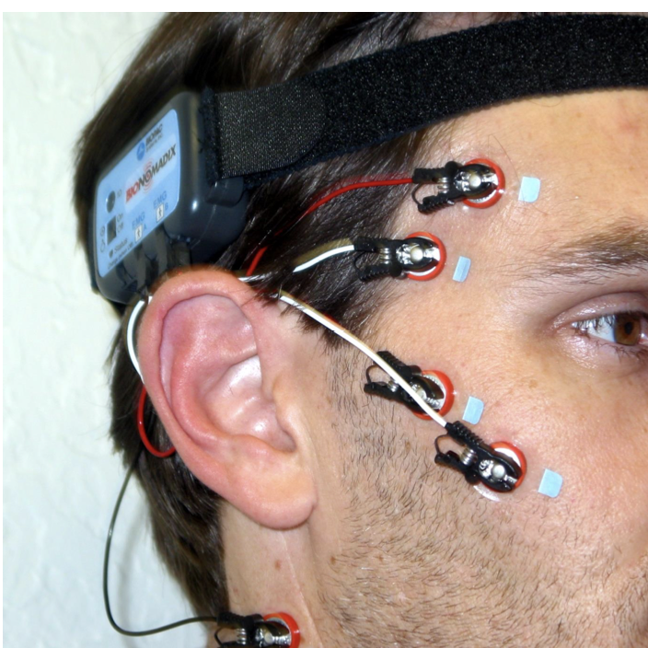
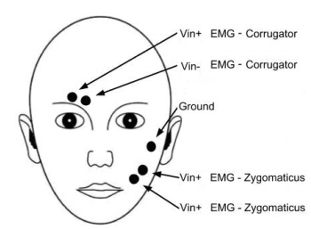
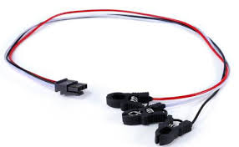
Brief protocol for measure fEMG in our lab
We use a wireless receptor known as a BIONOMADIX. Sends signal to BIOPAC.
ground
(black wire)
X
This goes on neck
Electrical wire that connects to surface electrodes
Historically we have used EL504 electrodes for best signal, though EL509 have been ok
(Sometimes the strap for the BIONOMADIX is too small for the head, so we wrap around the arm)

Slide 15
How do we measure fEMG?
Once the receptor is hooked up and turned on, it will send signals to the BIOPAC machine connected to the Mac computer.
The desktop runs the AcqKnowledge software which stores and processes the signal
Allows you to instantly view signal from fEMG and other physiological measures (SCR, HR, EEG, etc.)
Importantly, it allows us to export our data to .txt file we can analyze

Slide 16
What does fEMG data look like?
After you get the output from BIOPAC, it looks like a simple .txt file with a bunch of numbers

Slide 17
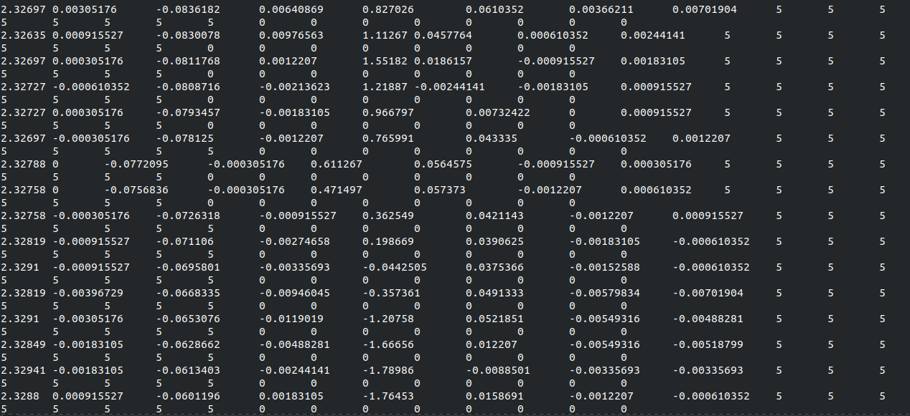
What does fEMG data look like?
After you get the output from BIOPAC, it looks like a simple .txt file with a bunch of numbers

Slide 18
How to understand fEMG data
Columns = channel
2.134 | 1.135 | 1.110 | 0.0114
2.155 | 1.14 | 1.120 | 0.015
2.164 | 1.143 | 1.111 | 0.0123
2.161 | 1.163 | 1.134 | 0.0111
Rows = sample

Slide 19
How to understand fEMG data
2.134 | 1.135 | 1.110 | 0.0114
2.155 | 1.14 | 1.120 | 0.015
2.164 | 1.143 | 1.111 | 0.0123
2.161 | 1.163 | 1.134 | 0.0111
A single row represents a single sample of surface level voltage.
This sample is taken once per the sampling rate which is provided by ACQ
The sampling rate is measured in Hz, which corresponds to cycles per second
For example, if the sampling rate is 1000Hz, then there will be 1000 samples (rows) per second, i.e., each row corresponds to 1 ms.

Slide 20
How to understand fEMG data
2.134 | 1.135 | 1.110 | 0.0114
2.155 | 1.14 | 1.120 | 0.015
2.164 | 1.143 | 1.111 | 0.0123
2.161 | 1.163 | 1.134 | 0.0111
A column represents a channel—i.e., a given measure or electrode.
In our case, we will have two fEMG channels/electrodes: one for corrugator and one for zygomaticus
Thus, the numbers in this column will represents volts as we saw before
We can have other channels for other measures like SCR or HR, which will be in other columns and sometimes have different units than volts

Slide 21
How do we keep track of things
The BIOPAC machine records channels of information for each physiological measure we input into it at a continuous rate (sampling rate)
This means that what we are left with is just a bunch of numbers
But how do we we know which numbers correspond to the events we interested in?

Slide 22
How do we keep track of things
+
???
Red
+
+10

Slide 23
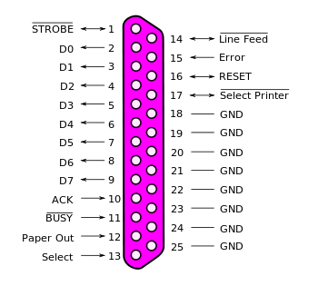
How do we keep track of things
To keep track of where we are at in the task within the same output as our signals, we can send triggers through a parallel port
Each of these pins can be off (0V) or on (5V)
We can treat ‘on’ and ‘off’ as ‘1’ and ‘0’ to produce binary numbers between 0 (all off) and 255 (2⁸; all on)
0 = 0000000
1 = 1111111
When plugged into the BIOPAC machine, each (data) pin will be treated as a channel (we’ll see this soon)

Slide 24
How do we keep track of things
To keep track of where we are at in the task within the same output as our signals, we can send triggers through a parallel port
Triggers—dummy voltage signal that exists just to organize the data
Parallel port—old computer 8-bit input port that sends information in parallel rather than serially (like USB)

Slide 25
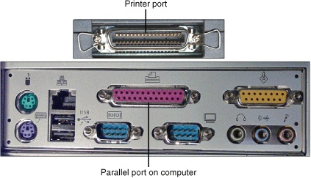
How do we keep track of things
To keep track of where we are at in the task within the same output as our signals, we can send triggers through a parallel port

Slide 26
How do we keep track of things
To keep track of where we are at in the task within the same output as our signals, we can send triggers through a parallel port

Slide 27
How do we keep track of things
To keep track of where we are at in the task within the same output as our signals, we can send triggers through a parallel port
These are are 8 bits of data that we can transmit from the computer to the BIOPAC machine

Slide 28
How do we keep track of things
To keep track of where we are at in the task within the same output as our signals, we can send triggers through a parallel port
00000001 = 1

Slide 29
How do we keep track of things
To keep track of where we are at in the task within the same output as our signals, we can send triggers through a parallel port
00000010 = 2

Slide 30
How do we keep track of things
To keep track of where we are at in the task within the same output as our signals, we can send triggers through a parallel port
00000011 = 3

Slide 31
How do we keep track of things
To keep track of where we are at in the task within the same output as our signals, we can send triggers through a parallel port
01001011 = 75

Slide 32
How do we keep track of things
To keep track of where we are at in the task within the same output as our signals, we can send triggers through a parallel port
This gives us 255 unique triggers we can work with to code events in our task (stimulus onsets, responses, etc.)
These binary values represent the status (on/off) of each pin channel, allowing to keep track of the task events next to our signals
These triggers are sent from our experimental code directly to the parallel port plugged into the BIOPAC, which is plugged into the recording machine (iMac in our case)
+
00000001
Red
00000010
+
00000011
+10
01001011

Slide 33
How do we keep track of things
Remember, 5 = 5V i.e., ‘on’
SCR | EMG | Trig 1 | Trig 2 | Trig 3 | Trig 4 | Trig 5 | Trig 6 | Trig 7 | Trig 8
2.134 | 0.0114 | 0 | 0 | 0 | 0 | 0 | 0 | 0 | 0
2.155 | 0.015 | 0 | 0 | 0 | 0 | 0 | 0 | 0 | 5
2.164 | 0.0123 | 0 | 0 | 0 | 0 | 0 | 0 | 5 | 0
2.161 | 0.0111 | 0 | 0 | 0 | 0 | 0 | 0 | 5 | 5
3.55 | 0.0555 | 0 | 5 | 0 | 0 | 5 | 0 | 5 | 5
These labels won’t be in the raw data; just for explanation

Slide 34
How do we analyze the data
Now that we know how the data is structured, let’s turn to analyzing it
First, I’ll show some pseudo-code and then Python code.
Don’t focus too much on the Python code if you don’t understand, you can always review it later. Just get your head around the concept.

Slide 35
How do we analyze the data
Now that we know how the data is structured, let’s turn to analyzing it
The basic process is as follows:
Select a window of time around the events of interest (triggers)
This is known as an epoch
Specify a baseline period (before the event) and signal (during/after the event)
Clean the signal
Compute a summary statistic for that event that trial
Save this summary statistic for all events of interest

Slide 36
Selecting a window of time around trigger
load(data)
Baseline = []
Signal = []
SAMPLING_RATE = 1000 # 1 sample = 1 ms
Go through each line of data {
If trigger channels == ‘00000050’ {
Add last (1 * SAMPLING_RATE) lines to Baseline # 1000 ms before trigger
Add next 1s (1 * SAMPLING_RATE) lines to Signal # 1000 ms after trigger
}
}

Slide 37
Selecting a window of time around trigger
Trigger? No.
0.0114 | 0 | 0 | 0 | 0 | 0 | 0 | 0 | 0
0.015 | 0 | 0 | 0 | 0 | 0 | 0 | 0 | 5
0.0123 | 0 | 0 | 0 | 0 | 0 | 0 | 5 | 0
0.0111 | 0 | 0 | 0 | 0 | 0 | 0 | 5 | 5
0.0555 | 0 | 5 | 0 | 0 | 5 | 0 | 5 | 5
...

Slide 38
Selecting a window of time around trigger
0.0114 | 0 | 0 | 0 | 0 | 0 | 0 | 0 | 0
0.015 | 0 | 0 | 0 | 0 | 0 | 0 | 0 | 5
0.0123 | 0 | 0 | 0 | 0 | 0 | 0 | 5 | 0
0.0111 | 0 | 0 | 0 | 0 | 0 | 0 | 5 | 5
0.0555 | 0 | 5 | 0 | 0 | 5 | 0 | 5 | 5
...
Trigger? No.

Slide 39
Selecting a window of time around trigger
0.0114 | 0 | 0 | 0 | 0 | 0 | 0 | 0 | 0
0.015 | 0 | 0 | 0 | 0 | 0 | 0 | 0 | 5
0.0123 | 0 | 0 | 0 | 0 | 0 | 0 | 5 | 0
0.0111 | 0 | 0 | 0 | 0 | 0 | 0 | 5 | 5
0.0555 | 0 | 5 | 0 | 0 | 5 | 0 | 5 | 5
...
Trigger? Yes!

Slide 40
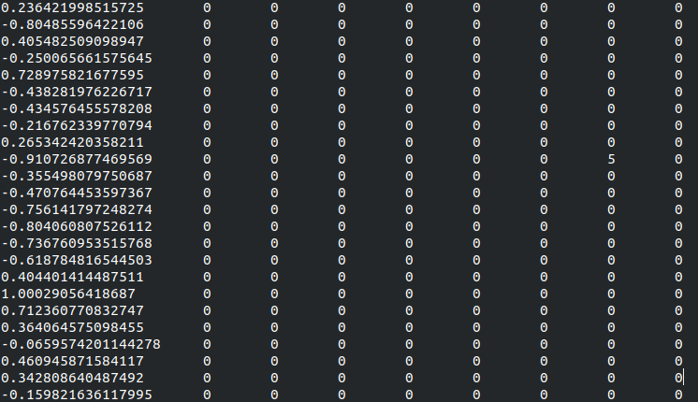
Selecting a window of time around trigger
Here’s the trigger

Slide 41
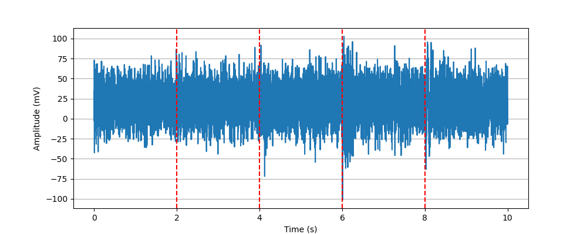
Selecting a window of time around trigger
Time = (1 second/SAMPLING RATE)*lines
So here, 1 ms = 1 line
Red = stimulus onset

Slide 42
Selecting a window of time around trigger
Baseline
Signal of interest
Time = (1 second/SAMPLING RATE)*lines
So here, 1 ms = 1 line
Red = stimulus onset

Slide 43
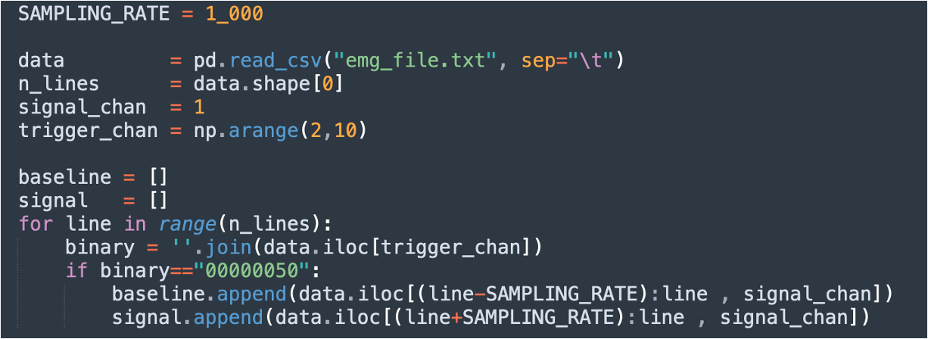
2. Specify a baseline period and signal period

Slide 44
3. Clean the data
There are many different approaches and philosophies to cleaning EMG data (or any physiological data… heck, any data at all!)
Here, I’ll show the absolute most simple to follow.
This does not mean you should necessarily do this for your publishable data. As in all analyses, think about what is best for you, what makes most sense, and what solves most problems with as few downsides as possible.
Data analysis is an art and a science.
This paper is a very useful intro and guide from a leader in the field

Slide 45
3. Clean the data
Steps:
Filter signal
Rectify signal
(Notch signal – Van Boxtel, 2010 suggestion)
Explain first, code at the end

Slide 46
3. Clean the data: Filter the data
fEMG is a noisy measure; alongside the actual signal we are interested in, there is uninteresting noise.
Slow frequencies can come from movement
Fast frequencies can come from noise interference from electronics or whatnot
In general, true EMG signals of interest exists within 20Hz-450Hz (though some people use 20Hz - 500Hz)
Thus, we are going to filter our data for signals in that range

Slide 47
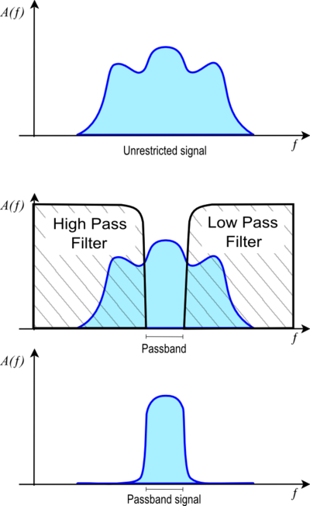
3. Clean the data: Filter the data
In theory, we could just delete all values outside of this range. But it is hard to specify a strict cutoff—if we say 40Hz is ok, do we really think 39.9Hz is categorically non-relevant?
As a result, we can use a bandpass filter to allow a specific range of frequencies (a band) to pass through while attenuating frequencies both below and above that band.
In R, we can use the signals package to accomplish, which implements this function for us.
This is known as low and high pass filtering the data, which when combined forms a bandpass

Slide 48
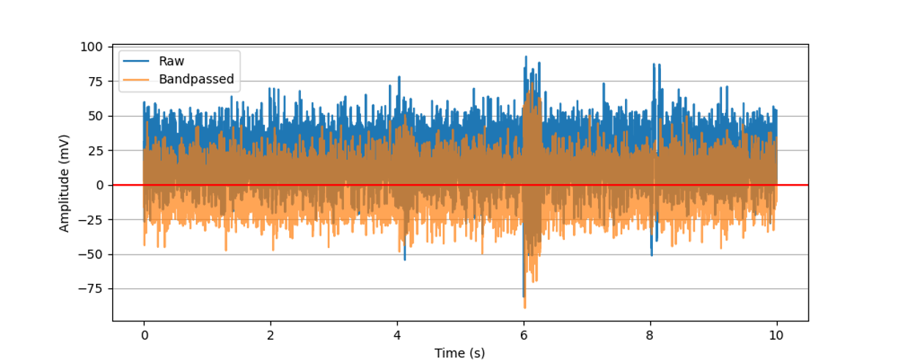
3. Clean the data: Filter the data
Note: this also centers the signal at 0

Slide 49
3. Clean the data: Rectify the data
Finally, we rectify the data, which just means to take the absolute value of each signal (make it all positive)
This is done to avoid the negative values from cancelling out the positive values

Slide 50
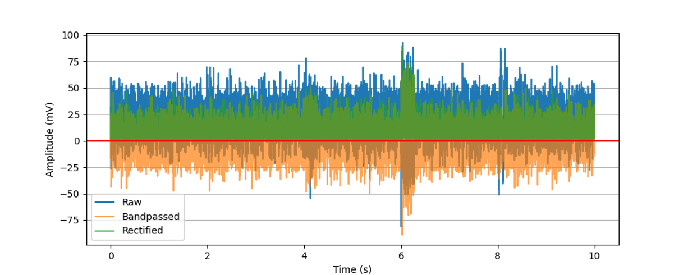
3. Clean the data: Filter the data

Slide 51
3. Clean the data: Notch filter
Van Boxtel (2010) says:
“In most practical applications occurring outside an electrically-shielded laboratory, it may also be necessary to remove 50-Hz power line interference by applying 50-Hz notch filtering”
In practice, I found this does very little, but nevertheless it is simple so why not do it.

Slide 52
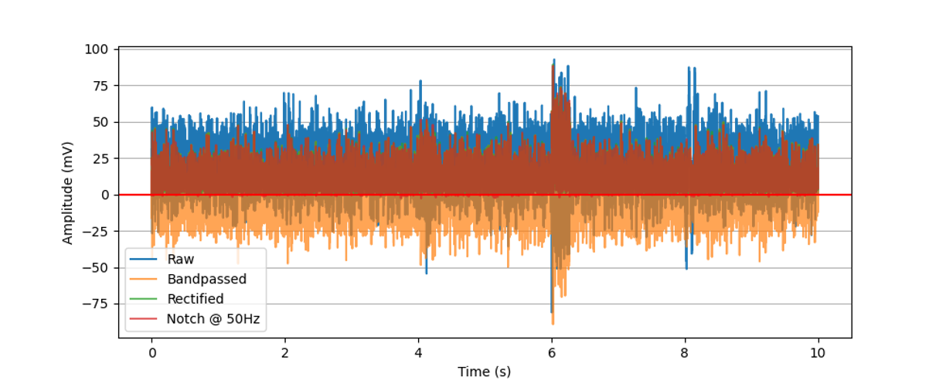
3. Clean the data: Notch filter at 50Hz

Slide 53
3. Clean the data: BONUS → 1D Gaussian filter
I haven’t seen anyone actually use this for EMG signal processing before, but it seems like a relevant technique that could be applied after bandpass filtering, and before rectifying.
Assumes that + and - noise cancel out; takes an average of local values within a window to construct a new signal.
This is not too different from what we will do next during summarizing

Slide 54
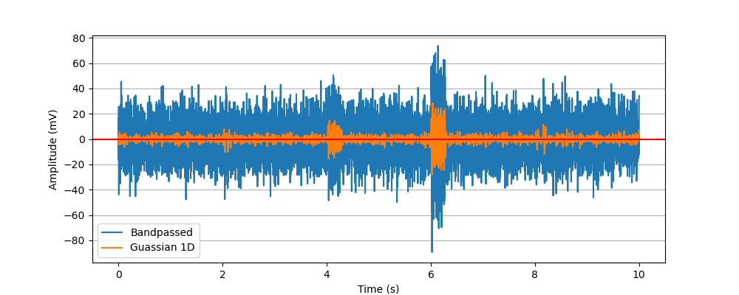
3. Clean the data: BONUS → 1D Gaussian filter

Slide 55
4. Summarizing the signal
Once you have your processed signal for an epoch, you need to create a single value to represent that signal (i.e., that trial, that stimulus, etc.)
The simplest you could do is the mean: mean(signal)
Alternatively, you can baseline-correct the mean signal: mean(signal) – mean(baseline)
Some people use a ratio: Mean(signal)/mean(baseline)
Others use a max-to-mean approach: Max(signal)/mean(baseline)
Lots is possible here.

Slide 56
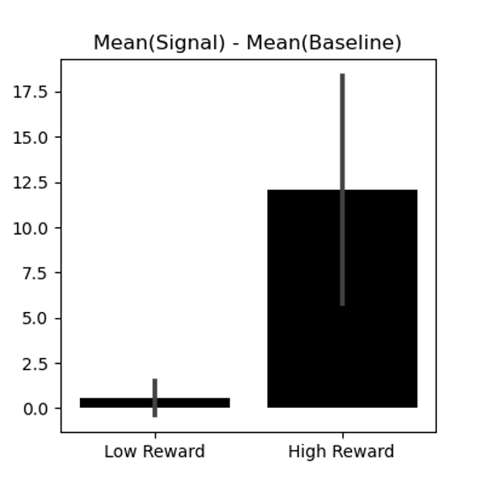
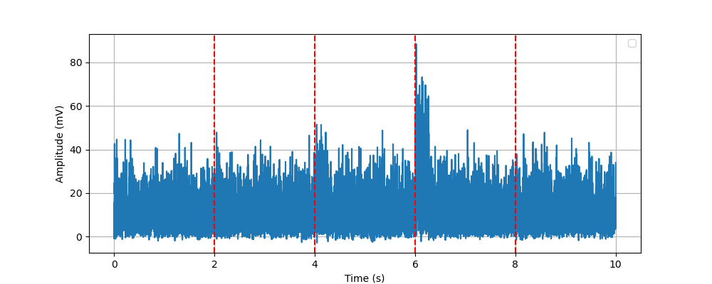
4. Summarizing the signal
For example, imagine:
Low reward
High reward
High reward
Low reward
Baseline
Signal of interest
Signal this trial = Mean(Signal of interest) – Mean(Baseline)
No difference before/after stimulus appears
Higher activation after stimulus appears

Slide 57
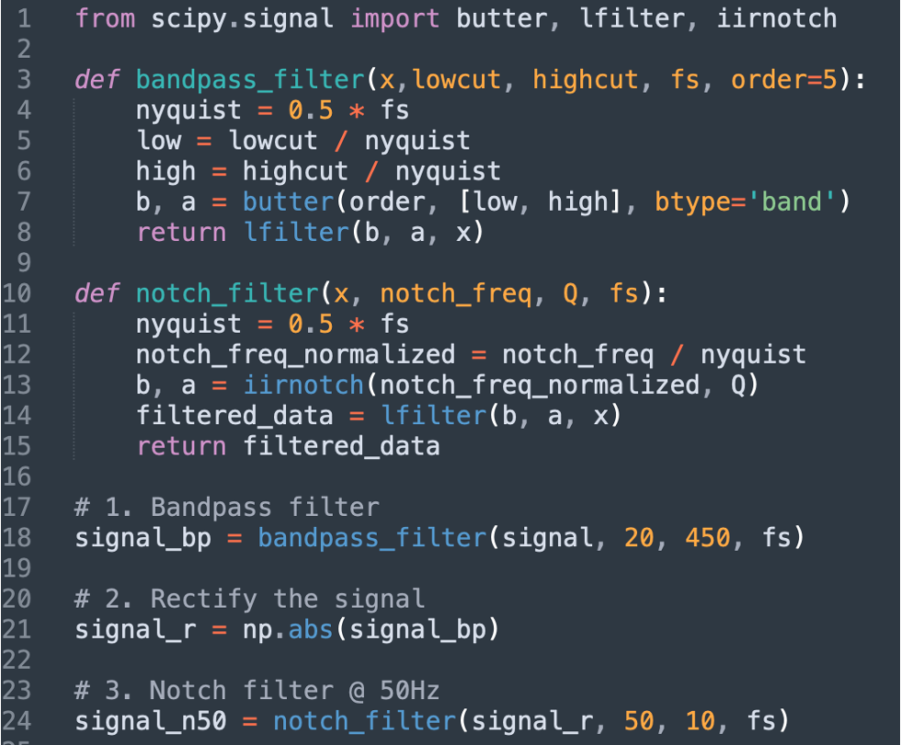
Cleaning script

Slide 58
Analyzing summarized signals
Once you’ve processed and summarized your signals, you can perform traditional stats on the summarized signals, because you’ll have one value per trial.
For example:
Does high effort increase corrugator activity?
T-test on signals from high vs. low effort stimuli
Do risky wins incur greater zygomaticus activity compared to safe loses?
ANOVA on signals from risky/safe wins/losses.
Etc., etc. etc.,

Slide 59
Conclusion
We’ve seen the following
What is fEMG
How fEMG works
How the triggers work
What fEMG data looks like
One way to process fEMG data

Slide 60
Conclusion
Many of the specifics will depend on your measures and your research, but these are the broad strokes.
So long as you understand the structure of the data and the idea of signal processing, you can work out the specifics.
Use this knowledge as you see fit

Slide 61
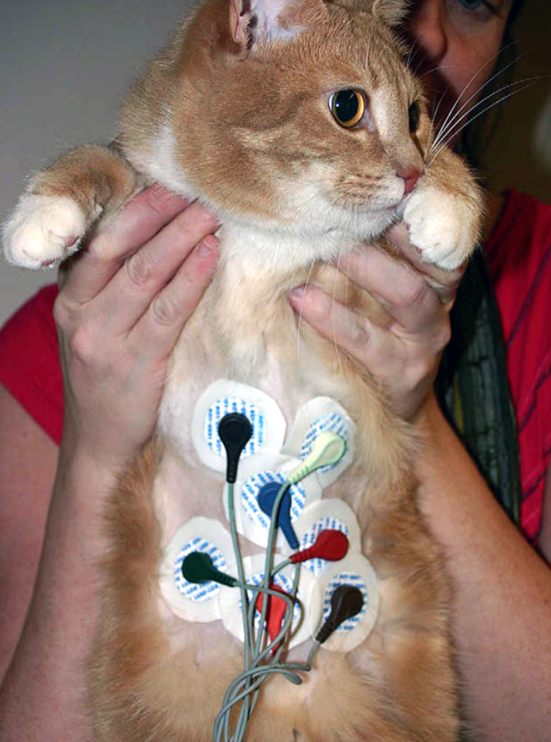
Conclusion
Many of the specifics will depend on your measures and your research, but these are the broad strokes.
So long as you understand the structure of the data and the idea of signal processing, you can work out the specifics.
Use this knowledge as you see fit →

Slide 62
Conclusion
Questions? :)

